Slide 1



Financial Results
FINANCIAL YEAR
2022

Slide 2

FY 2022 – FINANCIAL SUMMARY
Detail
Detail

Slide 3
FY2022 – SALES VOLUME
Back
Segmented Sales Volume

Slide 4
FY2022 – SEGMENTED SALES VOLUME
Back

Slide 5

FY2022 TOTAL SALES
Back
Column1 | FY - 2022 | FY – 2021 | Column2 | CHANGE
 |  |  | AMOUNT | RATIO
AUTOMOBILE | 45,881 | 34,892 | 10,988 | 31.5%
MOTORCYCLE | 1,855 | 1,205 | 650 | 53.9%
TOTAL | 47,736 | 36,097 | 11,638 | 32.2%
Sales Variance Analysis – Total

Slide 6
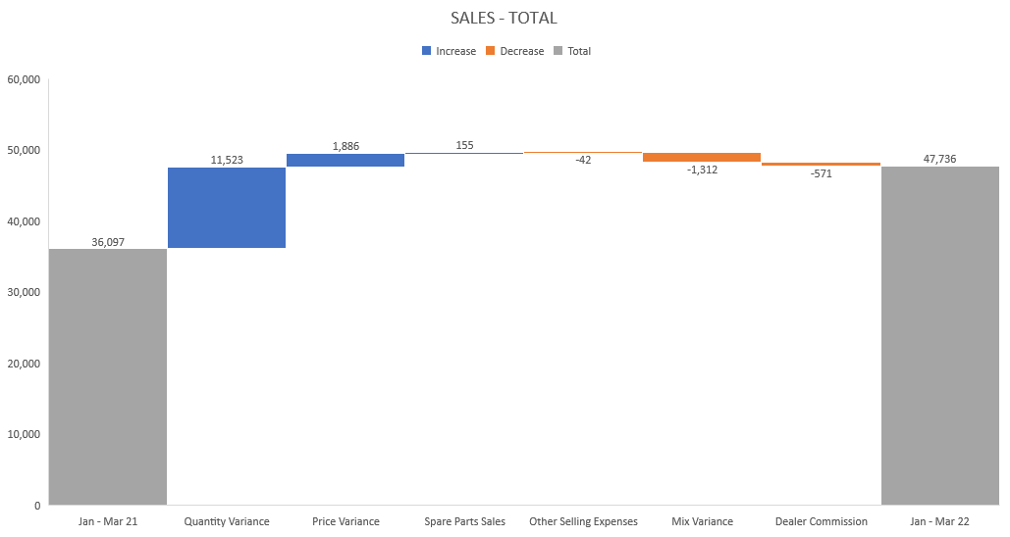
FY2022 – TOTAL SALES
Back

